Slide 2
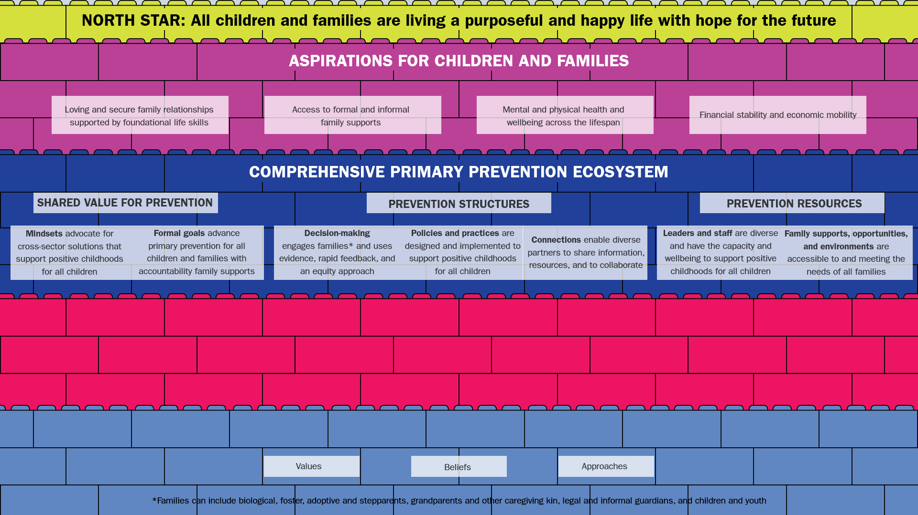
[INSERT ENTITY] STRATEGIES
[Insert your strategies here]
[Insert your strategies here]
[Insert your strategies here]
[Insert your strategies here]
[Insert your strategies here]
[INSERT ENTITY] VALUES, BELIEFS, AND APPROACHES

